Slide 1


`
Schulich School of Business MBAN 6110
MODULE 3 : Statistical learning
Data Science I
Instructor: Boris Garbuzov
MBAN 6110
Fall 2020
SCHULICH SCHOOL OF BUSINESS | MBAN 6110
MODULE 1
Data Science I
2020

Slide 2
Agenda
Textbook chapter 2. Statistical learning. Pages 15-56
Learning function
Model accuracy
Bayesian classifier
No predictors case
One and two predictors
Ideal Bayesian classification rate
Estimation of probabilities
Conditional independence. Naive Bayes
Python implementation
K nearest neighbors classifier
Distance between observations
Python implementation
Questions and discussion (last 10 minutes)
2 / 30

Slide 3
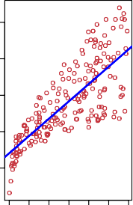
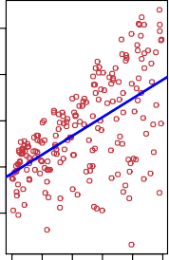
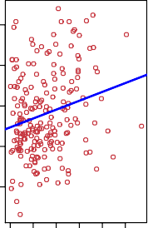
What is Statistical Learning?
25
25
25
20
20
20
Sales
15
Sales
15
Sales
15
10
10
10
5
5
5
0 50 100
200
300
0 10 20 30 40 50
0 20 40 60 80 100
TV Radio Newspaper
Shown are Sales vs TV, Radio and Newspaper, with a blue linear-regression line fit separately to each.
Can we predict Sales using these three? Perhaps we can do better using a model
Sales ≈ f (TV, Radio, Newspaper)
3 / 30

Slide 4
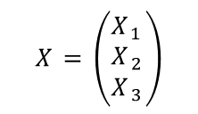
Notation
Here Sales is a response or target that we wish to predict. We generically refer to the response as Y .
TV is a feature, or input, or predictor; we name it X₁. Likewise name Radio as X₂, and so on.
We can refer to the input vector collectively as
$$X=\left(\begin{matrix}X_{1} \\ X_{2} \\ X_{3}\end{matrix}\right)$$
Now we write our model as
Y = f (X) + є
where є captures measurement errors and other discrepancies.
4 / 30

Slide 5
What is f(X) good for?
With a good f we can make predictions of Y at new points X = x.
We can understand which components of
X = (X₁, X₂, . . . , X_{p}) are important in explaining Y , and which are irrelevant. e.g. Seniority and Years of Education have a big impact on Income, but Marital Status typically does not.
Depending on the complexity of f , we may be able to understand how each component X_{j} of X affects Y .
5 / 30

Slide 6
6
●●
● ●
●●
● ● ●
●●● ● ●
4
●●●●●●●●●●
● ●●● ● ●
● ●●●●●●●●● ●
●
● ●●●●●●
●●●●●●●●●● ●●
●●●●●● ●●●●●
●●
●●●●●●●●●●●●●
y
● ●●●●●●●●●●●●●●●
2
● ●●●●●●●●● ●●●●●●●
● ●●●●●●●●●●●●●● ●
●
●●●●●●●●●●●●●●●●●●●●●●●●●
●●●●●●●●●●●●●●●● ●●●●● ●
●
●
●●●●●●●●●●●●●●●●●●●●●●●●●
●
● ●●●●●●●●●●●●●●●●●●●●●●●●●●●●●
● ●
● ●●●●●●●●●●●●●●●●●●●●●●●●●●●
● ●
●●● ●●●●●●●●●●●●●●●●●●●●● ●●●●●●●●●●●●●●●●●●
●
●●
●● ●●●●●●●●● ●●●●●●●●●●●●●●● ●●●●●●
−2 0
● ●●● ● ●●●● ●●●●●●● ●●●●● ●●●●●●●●●●●●●●●●●●●●●
●● ●●● ●●● ●●● ●●●●●●●●●●●●●●●●●●●●●●●●●● ●●●●●●●●●●●●●●
● ● ●●●●●●●●●●●●●●●●●●●●●●●●●●●●●●●●●●●●●●●●●●● ●●●
●● ●●●●●●●●●●●●●●●●●●● ●●● ●●● ●●●●●●●●●●●●●●●●●
●●●●● ●●●●●●●●●●●●●●●●●●●●●●●●●●●●●●●● ●
●●● ●●●●● ●●●●●●●●●●●●●●●●● ●● ●●● ●
●● ●●●●●●●●●●●●●●● ● ●●●●●
● ● ●●●●●●●●●●● ●●● ●● ●
●
●● ● ●●
1
2
3 4
x
5
6
7
Is there an ideal f(X)? In particular, what is a good value for f(X) at any selected value of X, say X = 4? There can be many Y values at X = 4. A good value is
f (4) = E(Y |X = 4)
E(Y |X = 4) means expected value (average) of Y given X = 4.
This ideal f (x) = E(Y | X = x) is called the regression function.
4 / 30

Slide 7

The regression function f(x)
Is also defined for vector X; e.g.
f (x) = f (x₁, x₂, x₃) = E(Y | X₁ = x₁, X₂ = x₂, X₃ = x₃)
Is the ideal or optimal predictor of Y with regard to
mean-squared prediction error: f (x) = E(Y |X = x) is the function that minimizes E[(Y − g(X))²|X = x] over all functions g at all points X = x.
s = Y − f (x) is the irreducible error — i.e. even if we knew f(x), we would still make errors in prediction, since at each X = x there is typically a distribution of possible Y values.
For any estimate f^{ˆ}(x) of f(x), we have
$$E[(Y−\hat{f}(X{))}^{2}|X=x]={\underset{Reducible}{\underbrace{\left[f\left(x\right)−\hat{f}\left(x\right)\right]}}}^{2}+\underset{Irreducible}{\underbrace{Var(ε)}}$$

Slide 8
Why Do We Estimate f?
Statistical Learning, and this course, are all about how to estimate f.
The term statistical learning refers to using the data to “learn” f.
Why do we care about estimating f?
There are 2 reasons for estimating f,
Prediction and Inference.

Slide 9
1. Prediction
If we can produce a good estimate for f (and the variance of ε is not too large) we can make accurate predictions for the response, Y, based on a new value of X.

Slide 10
Example: Direct Mailing Prediction
Interested in predicting how much money an individual will donate based on observations from 90,000 people on which we have recorded over 400 different characteristics.
Don’t care too much about each individual characteristic.
Just want to know: For a given individual should I send out a mailing?

Slide 11
2. Inference
Alternatively, we may also be interested in the type of relationship between Y and the X's.
For example,
Which particular predictors actually affect the response?
Is the relationship positive or negative?
Is the relationship a simple linear one or is it more complicated etc.?

Slide 12
Example: Housing Inference
Wish to predict median house price based on 14 variables.
Probably want to understand which factors have the biggest effect on the response and how big the effect is.
For example how much impact does a river view have on the house value etc.
The Boston house-price data
http://lib.stat.cmu.edu/datasets/boston

Slide 13
How to estimate f
Typically we have few if any data points with X = 4 exactly.
So we cannot compute E(Y |X = x)!
Relax the definition and let
f^{ˆ}(x) = Ave(Y |X ∈ N(x))
where N (x) is some neighborhood of x.
−2 −1 0 1 2 3
● ●
●
●
●●
●
●
●
● ●●
●
● ●
● ●
● ●●●
y
● ● ● ●●
●●
●●●
●
●
● ●
● ● ● ●
●
●
●
●
● ● ● ●
●
● ●
●
● ●● ● ● ● ●
● ●● ●●
● ● ●
●
1
2
3
4
5
6
x

Slide 14
Parametric Methods
It reduces the problem of estimating f down to one of estimating a set of parameters.
They involve a two-step model based approach
STEP 1:
Make some assumption about the functional form of f, i.e. come up with a model. The most common example is a linear model i.e.
However, in this course we will examine far more complicated, and flexible, models for f. In a sense the more flexible the model the more realistic it is.

Slide 15
Parametric Methods (cont.)
STEP 2:
Use the training data to fit the model i.e. estimate f or equivalently the unknown parameters such as
β₀, β₁, β₂,…, β_{p}.
The most common approach for estimating the parameters in a linear model is ordinary least squares (OLS).
However, this is only one way.
We will see in the course that there are often superior approaches.

Slide 16
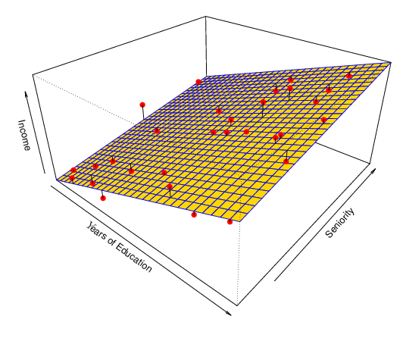
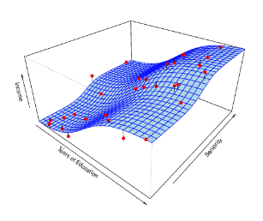
Example: A Linear Regression Estimate
Even if the standard deviation is low we will still get a bad answer if we use the wrong model.
$$f\left(x\right)=β_{0}+β_{1}⋅ⅇducatⅈon+β_{2}⋅seniority$$

Slide 17
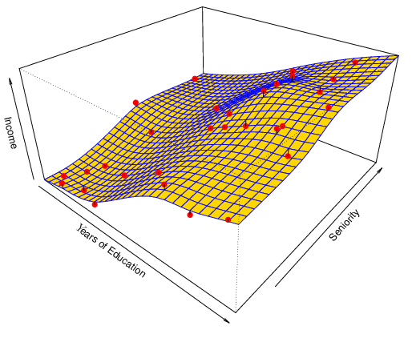
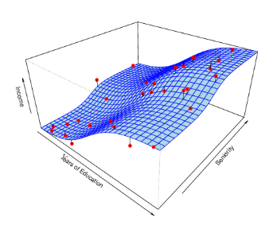
Example: A Thin-Plate Spline Estimate
Non-linear regression methods are more flexible and can potentially provide more accurate estimates.

Slide 18
A linear model f^{ˆ}_{L}(X) = β^{ˆ}₀ + β^{ˆ}₁ X. gives a reasonable fit here
−2 −1 0 1 2 3
● ●
●
●
●●
●
●
●
● ●
●
●●
●
●
● ● ●●
● ●●●
y
●
●
● ●● ●●
●
●
●
●
●
● ●
● ●●
●
●
● ● ●
●
● ●
●
● ●●
● ● ● ●
● ●● ●●
● ● ●
●
1 2 3 4 5 6
x
A quadratic model f^{ˆ}_{Q}(X) = β ^{ˆ}₀ + β^{ˆ}₁ X + β^{ˆ}₂ X ² fits slightly better.
−2 −1 0 1 2 3
● ●
●
●
●●
●
● ●
● ●
●●
● ●
y
● ● ●●
● ●●●
●
●
● ●
●● ●●
●
●
●
● ●
● ●●
● ●
●
● ● ●
●
● ●
●
●
● ●●
● ● ● ●
● ●● ●●
● ● ●
●
1
2
3
4
5
6
x

Slide 19
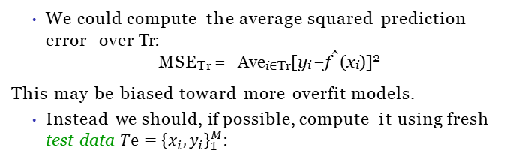
Assessing Model Accuracy
Suppose we fit a model f^{ˆ}(x) to some training data
$T_{r}={\left\{x_{i,}y_{i}\right\}}_{1}^{N}$, and we wish to see how well it performs.
We could compute the average squared prediction error over Tr:
MSE_{Tr} = Ave_{i∈Tr}[y_{i} − f^{ˆ}(x_{i})]²
This may be biased toward more overfit models.
Instead we should, if possible, compute it using fresh test data $Tⅇ={\left\{x_{i},y_{i}\right\}}_{1}^{M}$:
MSE_{Te} = Ave_{i∈Te}[y_{i} − f^{ˆ}(x_{i})]²

Slide 20
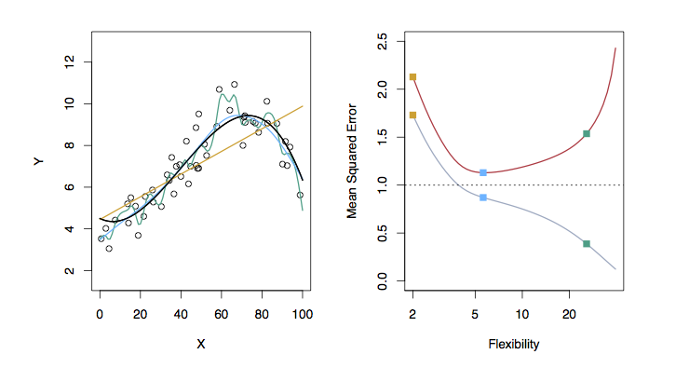
Examples with Different Levels of Flexibility: Example 1
LEFT
Black: Truth
Orange: Linear Estimate
Blue: smoothing spline
Green: smoothing spline (more flexible)
RIGHT
RED: Test MSE
Grey: Training MSE
Dashed: Minimum possible test MSE (irreducible error)

Slide 21
Classification Problems
Here the response variable Y is qualitative — e.g. email is one of C = (spam, ham) (ham=good email), digit class is one of C = {0, 1, . . . , 9}. Our goals are to:
Build a classifier C(X) that assigns a class label from C to a future unlabeled observation X.
Assess the uncertainty in each classification
Understand the roles of the different predictors among
X = (X₁, X₂, . . . , X_{p}).
21 / 30

Slide 22
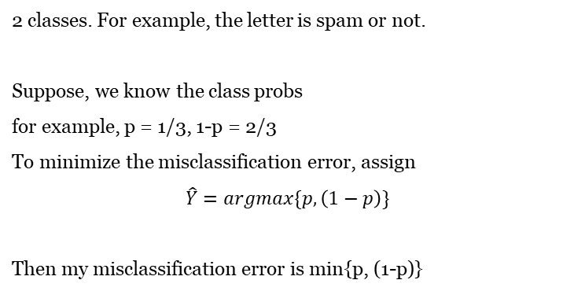
Ideal prior
2 classes. For example, the letter is spam or not.
Suppose, we know the class probs
for example, p = 1/3, 1-p = 2/3
To minimize the misclassification error, assign
$$\hat{Y}=argmax\{p, \left(1−p\right)\}$$
Then my misclassification error is min{p, (1-p)}
p | 1-p

Slide 23
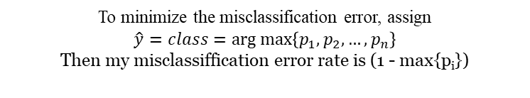
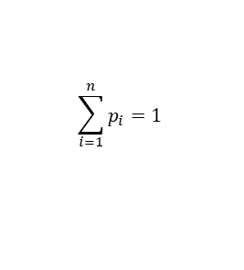
Ideal prior classifier
Class | C₁ | C₂ | … | C_{n}
Probability | p₁ | p₂ | … | p_{n}
$$\sum_{i=1}^{n}{p_{i}}=1$$
To minimize the misclassification error, assign
$$\hat{y}=class=\arg{\max\left\{p_{1},p_{2},…,p_{n}\right\}}$$
Then my misclassiffication error rate is (1 - max{p_{i}})

Slide 24
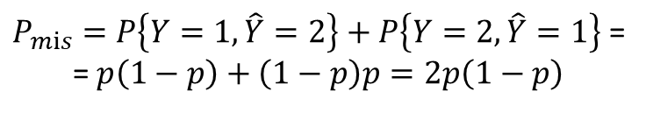

Ideal prior
Let us compare this choice to another tempting solution to randomize my decision independently, assigning
{
1, p
$$\hat{Y}=$$
2, 1-p
Here p is the same true known P{Y=1}.
Then the probability of misclassification
$P_{mⅈs}=P\left\{Y=1,\hat{Y}=2\right\}+P\left\{Y=2,\hat{Y}=1\right\}$ =
= $p\left(1−p\right)+\left(1−p\right)p=2p\left(1−p\right)$

Slide 25

Ideal prior
$$\frac{1}{2}$$
determinstic ≤ randomized
0
1
p
$$\frac{1}{2}$$
Since there is no x, the posterior probability is just prior

Slide 26
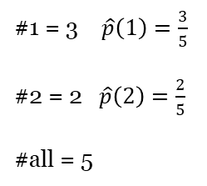

Estimating prior probabilities
${\hat{p}}_{i}$= relative frequency(i) = $\frac{\#ⅈ}{\#all}$
#1 = 3 $\hat{p}\left(1\right)=\frac{3}{5}$
#2 = 2 $\hat{p}\left(2\right)=\frac{2}{5}$
#all = 5
1
1
2
2
1

Slide 27
Ideal Bayes
Bayes classifier on Wiki
Probability space
Suppose, as before, we have 2 classes, and X predictor with 2 values. For example, presence of the word "free" in the letter. The minimal settings for Bayes classifier. Let the prior distribution of Y be given as before.
y₂
Ω
y₁
x
x₁
x₂
π₁=p | π₂=1-p
Let the conditional probabilities be given on top of it

Slide 28
Ideal Bayes
Y\X | x₁ | x₂
y₁ | P(X=x₁|Y=y₁) | P(x₂|y₁)
y₂ | P(x₁|y₂) | P(x₂|y₂)
In fact, only half should be given.
P(x₂|y₁)=1-P(x₁|y₁)
P(x₂|y₂)=1-P(x₁|y₂)
Then the posterior probabilities can be computed by Bayes's theorem
Same denominator. Compare two numerators
$$P(y_{1})P(x_{1}|y_{1})><P(y_{2})P(x_{1}|y_{2})$$

Slide 29





Ideal Bayes
$$Find \hat{Y}\left(x_{1}\right)$$
Choose max
Y\X | x₁ | x₂
y₁ | P(X=x₁|Y=y₁) | P(x₂|y₁)
y₂ | P(x₁|y₂) | P(x₂|y₂)
So I choose y_{2,} and my prediction is
$$\hat{Y}\left(x_{1}\right)=y_{2}$$
$$Find \hat{Y}\left(x_{2}\right)$$
Therefore, X is not a useful predictor. It does not discriminate Y. And our misclassification probability, for this distribution,
as before is just a minimal of two prior values = 2/5
2/5*2/3=0.2667 3/5*1/2=0.3
$\hat{Y}\left(x_{2}\right)=y_{2}$, as well.
So $\hat{Y}\left(X\right)=y_{2}$ always, for any value of X

Slide 30


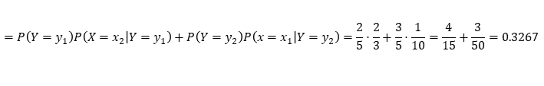

Ideal Bayes
Take another example
x₁: 2/5 * 1/3 = 0,1333 : y₁
3/5 * 1/10 = 0,06 : y₂
So now we choose y₁, when X= x₁
Now for x₂: 2/5 * 2/3 = 0.2667 : y₁
3/5 * 9/10 = 0.54 : y₂
Here we keep our choice of y₂, and the Bayes classifier is
Y\X | x₁ | x₂
y₁ | P(X=x₁|Y=y₁) | P(x₂|y₁)
y₂ | P(x₁|y₂) | P(x₂|y₂)
{
$$y_{1},X=x1$$
$$\hat{Y}\left(X\right)=$$
$$y_{2},X=x_{2}$$
And the misclassification error by disjoint additivity
$P\left(\hat{Y}≠Y\right)=P\left(Y=y_{1},\hat{Y}=y_{2} or Y=y_{2},\hat{Y}=y1\right)$ =
= $P\left(Y=y_{1},\hat{Y}=y_{2}\right)+P\left(Y=y_{2},\hat{Y}=y_{1}\right)=P\left(Y=y_{1},X=x_{2}\right)+P\left(Y=y_{2},X=x_{1}\right)$ =
$$=P\left(Y=y_{1}\right)P\left(X=\left.x_{2}\right|Y=y_{1}\right)+P\left(Y=y_{2}\right)P\left(x=\left.x_{1}\right|Y=y_{2}\right)=\frac{2}{5}⋅\frac{2}{3}+\frac{3}{5}⋅\frac{1}{10}=\frac{4}{15}+\frac{3}{50}=0.3267$$

Slide 31
Bayes Error Rate
The Bayes error rate refers to the lowest possible error rate that could be achieved if somehow we knew exactly what the “true” probability distribution of the data looked like.
On test data, no classifier (or stat. learning method) can get lower error rates than the Bayes error rate.
Of course in real life problems the Bayes error rate can’t be calculated exactly.
Bayes error rate on wilki

Slide 32
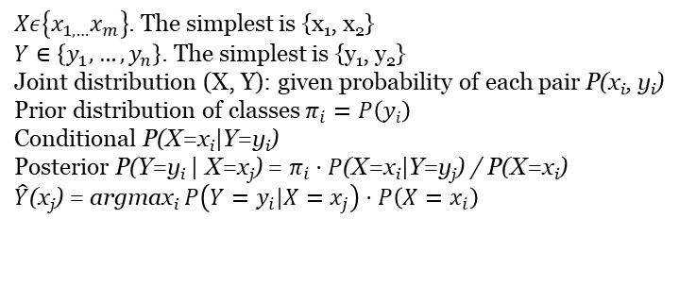
Ideal Bayes
What we did above is the best possible use of prior and conditional probabilities for classification. The proof is beyond the level of this course.
Ideal Bayes classifier
$Xε\left\{x_{1,…}x_{m}\right\}$. The simplest is {x₁, x₂}
$Y∈\left\{y_{1},…,y_{n}\right\}$. The simplest is {y₁, y₂}
Joint distribution (X, Y): given probability of each pair P(x_{i}, y_{i})
Prior distribution of classes $π_{i}=P\left(yi\right)$
Conditional P(X=x_{i}|Y=y_{i})
Posterior P(Y=y_{i} | X=x_{j}) = $π_{i}⋅P$(X=x_{i}|Y=y_{j}) / P(X=x_{i})
$\hat{Y}$(x_{j}) = argmax_{i} $P\left(Y=\left.y_{i}\right|X=x_{j}\right)⋅P\left(X=x_{i}\right)$

Slide 33
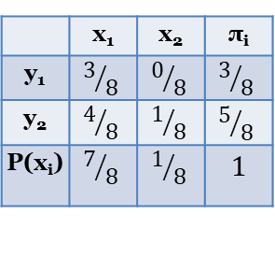


Estimating joint and conditional probabilities
Occurrences table
X
 | x₁ | x₁
y₁
y₂
Y
X
 | x₁ | x₂ | π_{i}
y₁ | $$3/8$$ | $$0/8$$ | $$3/8$$
y₂ | $$4/8$$ | $$1/8$$ | $$5/8$$
P(x_{i}) | $$7/8$$ | $$1/8$$ | 1
Y
joint
$$P\left(Y=y_{1},X=x_{2}\right)$$
3/8 + 0/8 + 4/8 + 1/8 = 1
marginal
$$P\left(Y=y_{2}\right)$$

Slide 34
Estimating joint and conditional probabilities
Estimates of conditional probabilities
X
 | x₁ | x₁
y₁ | 1 | 0 | 1
y₂ | 4/5 | 1/5 | 1
Y
Full conditional probability of a subcase Y= y₂

Slide 35
Bayes classifier quiz practice
Suppose, one of the classifiers in A-D is Bayesian. If r is the classifier's error rate, which of the classifiers is Bayesian?
A: r = 0.14
B: r = 0.137
C: r = 0.13
D: r = 0.135

Slide 36
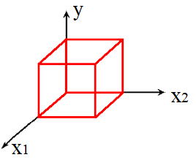
Two predictors
Joint distribution of 3 variables: X₁, X₂, Y
Again, we illustrate just the minimal case of 2 values each
Probability space of a size 2³ = 8
Use X₁, X₂ to predict Y
(X₁, X₂) -> Y
Tables of joint conditional
x₁
 | 1 | 2
1 | p₁₁ | p₁₂
2 | p₂₁ | p₂₂
 | 1 | 2
1 | q₁₁ | q₁₂
2 | q₂₁ | q₂₂
x₂
x₂

Slide 37

Two predictors
Suppose, we have our predictors X₁ = 1, X₂ = 1 What is the most precise prediction for Y? Again, we compute 2 posterior probabilities
and choose the larger. This will be an ideal Bayes classifier based on 2 predictors.
How to compute these posteriors? By Bayes formula.
$$P(Y=1|X_{1}=1,X_{2}=1) \\ P(Y=2|X_{1}=1,X_{2}=1)$$
Which one is bigger?
Both have the same denominator.
So we need to compare just numerators.

Slide 38
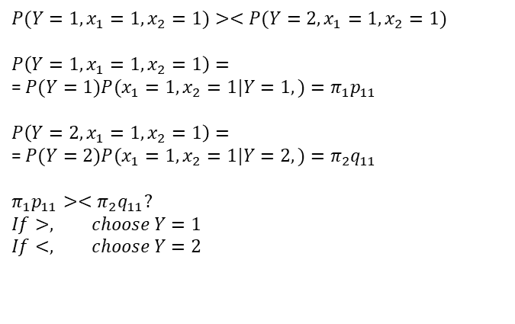
Two predictors
$$P(Y=1,x_{1}=1,x_{2}=1)><P(Y=2,x_{1}=1,x_{2}=1)$$
$$P\left(Y=1,x_{1}=1,x_{2}=1\right)=$$
= $P(Y=1)P(x_{1}=1,x_{2}=1|Y=1,)=π_{1}p_{11}$
$$P\left(Y=2,x_{1}=1,x_{2}=1\right)=$$
= $P(Y=2)P(x_{1}=1,x_{2}=1|Y=2,)=π_{2}q_{11}$
$$π_{1}p_{11}><π_{2}q_{11}? \\ If>, choose Y=1 \\ If<, choose Y=2$$

Slide 39
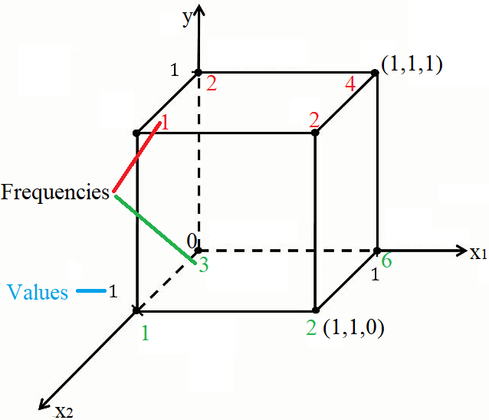
Fully estimated Bayes classifier example

Slide 40
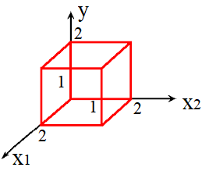
Conditional independence assumption
As, before, consider joint distribution of 3 variables: X₁, X₂, Y
Again, we illustrate just the minimal case of 2 values each
Probability space of a size 2³ = 8
Use X₁, X₂ to predict Y
x₁
dep
Cond. ind
Y
x₂
dep

Slide 41



Conditional independence assumption
But assume conditional independence of two predictors
This means, joint tables of X₁, X₂, conditioned on Y, contain products
x₂
 | p₂ | 1-p₂
p₁ | p₁p₂ | p₁ (1-p₂)
1-p₁ | (1-p₁)p₂ | (1-p₁) (1-p₂)
$$P(Y=1)=π_{1}$$
x₁
$$P(X_{1}=i,X_{2}=j|Y=1)= \\ =P(X_{1}=i|Y=1)P(X_{2}=j|Y=1)$$
Here i is one of the values of X₁ variable (in this case $ⅈ∈\left\{1,2\right\}$), and
j is one of the values of X₂ variable (in this case $j∈\left\{1,2\right\}$)

Slide 42
Conditional independence assumption
x₂
 | q₂ | 1-q₂
q₁ | q₁q₂ | q₁ (1-q₂)
1-q₁ | (1-q₁)q₂ | (1-q₁) (1-q₂)
x₁

Slide 43
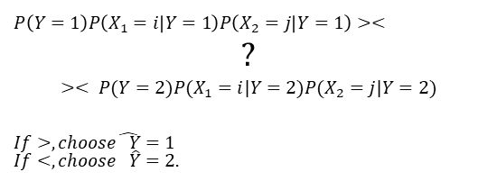
Conditional independence assumption
If our predictor pair is X₁=i, X₂=j .
How to make a decision on Y value? If all the above probabilities are given, we compare
$$P\left(Y=1\right)P\left(X_{1}=i | Y=1\right)\overset{ }{P\left(X_{2}=j | Y=1\right)}><$$
$$? \\ >< P(Y=2)P(X_{1}=i|Y=2)\overset{ }{P(X_{2}=j|Y=2)}$$
$$If>,choose\hat{ Y}=1 \\ If<,choose \hat{Y}=2.$$

Slide 44
Joint estimation based on independence
We assume independence of X₁ and X₂, both conditioned on Y
||
In terms of joint conditional cdf
Assumption of independence is one of the ways to get rid of gaps
First compute the marginal frequencies

Slide 45
Joint estimation based on independence. Example
Suppose we have the same occurrences table as in the previous slide
x₂
x₂
 | 1 | 2
1
2
 | 1 | 2
1
2
x₁
x₁
3+0=3
4+1=5
Y=1
Y=1
3+4=7
0+1=1
7+1=3+5=8

Slide 46
Joint estimation based on independence
Convert absolute frequencies to relative, dividing by the grand total
Fill the joint by the product of marginals
x₂
x₂
 | 1 | 2
1 | ? | ?
2 | ? | ?
 | 1 | 2
1
2
x₁
x₁
3/8
3/8
5/8
5/8
7/8
1/8
1
7/8
1/8
1

Slide 47
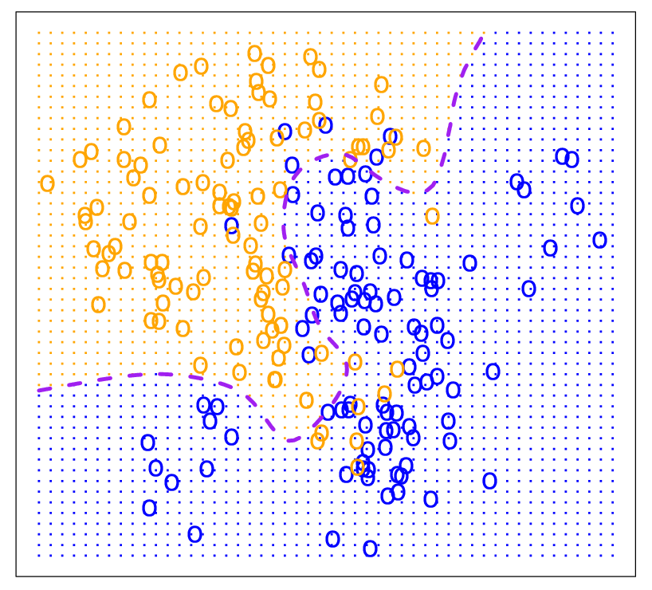
Bayes Optimal Classifier

Slide 48
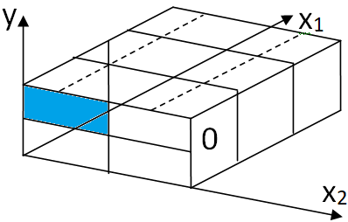
Naive Bayesian classifier
Naive Bayes classifier on Wiki
If we have many features, each taking on many values, our occurrence table will be sparse. This means, most of the cells will have zero frequency.
Having the direct estimated Bayes classifier will compare zeros in most of the cases.
That is why we better assume independence to estimate the probabilities.

Slide 49
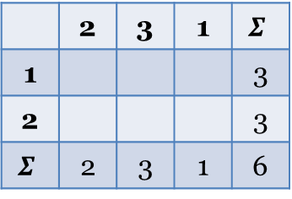
Naive Bayesian classifier
Suppose, we have the following occurrence table for the first class
If combination for some value x_{i} of variable X, and some value y_{i} of variable Y, the combination (x_{i}, y_{i}) did not occur in the training set, but it is expected in the testing set, it is recommended to add a very small frequency of this value, taking away from the other values.
x₁
 | 2 | 3 | 1 | $$Σ$$
1 |  |  |  | 3
2 |  |  |  | 3
$$Σ$$ | 2 | 3 | 1 | 6
x₂
Class Y=1

Slide 50
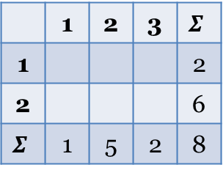
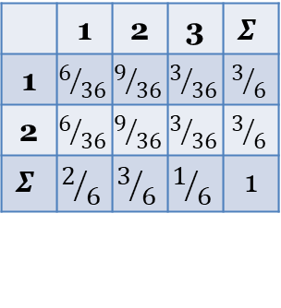
Naive Bayesian classifier
Compute joint conditional probabilities, assuming conditional independence
x₁
x₁
 | 1 | 2 | 3 | $$Σ$$
1 | $$6/{36}$$ | $$9/{36}$$ | $$3/{36}$$ | $$3/6$$
2 | $$6/{36}$$ | $$9/{36}$$ | $$3/{36}$$ | $$3/6$$
$$Σ$$ | $$2/6$$ | $$3/6$$ | $$1/6$$ | 1
 | 1 | 2 | 3 | $$Σ$$
1 |  |  |  | 2
2 |  |  |  | 6
$$Σ$$ | 1 | 5 | 2 | 8
x₂
x₂
Class Y = 1
Class Y = 2

Slide 51
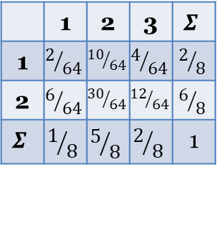

Naive Bayesian classifier
The grand total = 6 + 8 = 14
Now we can estimate the prior distribution of class variable Y
Assuming conditional independence, the product table for the second class is
x₁
 | 1 | 2 | 3 | $$Σ$$
1 | $$2/{64}$$ | $${10}/{64}$$ | $$4/{64}$$ | $$2/8$$
2 | $$6/{64}$$ | $${30}/{64}$$ | $${12}/{64}$$ | $$6/8$$
$$Σ$$ | $$1/8$$ | $$5/8$$ | $$2/8$$ | 1
Class Y = 2
x₂
$$π_{2}=\frac{8}{14}$$

Slide 52
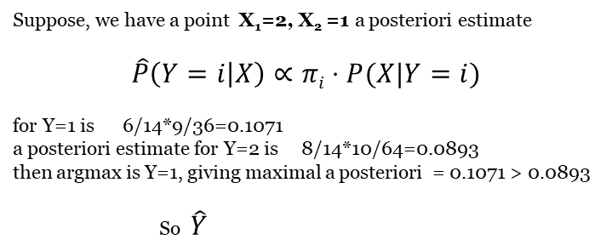
Naive Bayesian classifier
Suppose, we have a point X₁=2, X₂ =1 a posteriori estimate
$$\hat{P}\left(Y=i | X\right)∝πi⋅P(X|Y=i)$$
for Y=1 is 6/14*9/36=0.1071
a posteriori estimate for Y=2 is 8/14*10/64=0.0893
then argmax is Y=1, giving maximal a posteriori = 0.1071 > 0.0893
So $\hat{Y}$

Slide 53
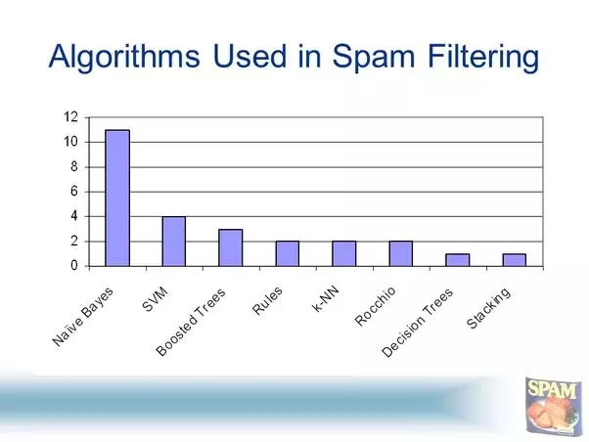
Naive Bayes in Python
Simple Naive Bayes – on GitHub colab
Spam filtration – on GitHub colab

Slide 54
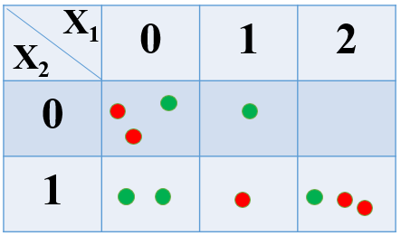
Naïve Bayes quiz practice. Problem setting
Using this data, choose the right answer for the following 4 questions

Slide 55
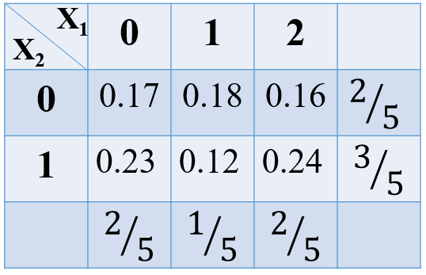
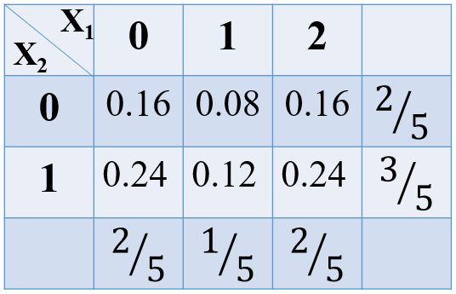
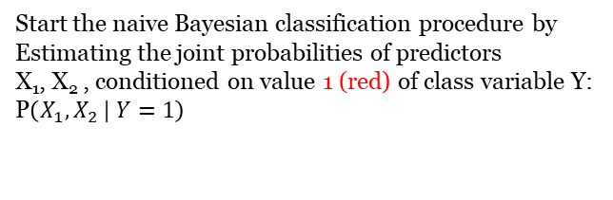
Naïve Bayes quiz practice. Question 1
Start the naive Bayesian classification procedure by
Estimating the joint probabilities of predictors
X₁, X₂ , conditioned on value 1 (red) of class variable Y:
P$\left(X_{1},\left.X_{2 }\right| Y=1\right)$
a.
b.

Slide 56
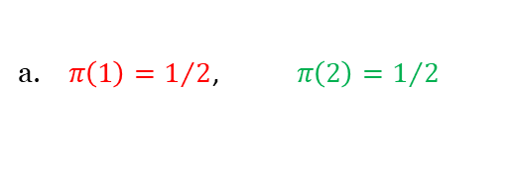
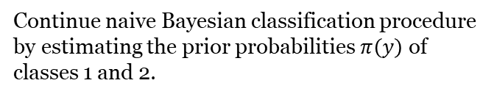
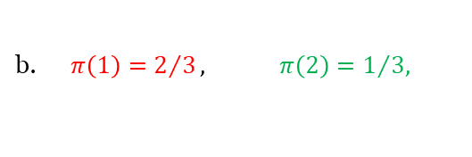
Continue naive Bayesian classification procedure by estimating the prior probabilities $π\left(y\right)$ of classes 1 and 2.
Naïve Bayes quiz practice. Question 2
a. $π\left(1\right)=1/2$, $π\left(2\right)=1/2$
b.$π\left(1\right)=2/3, π\left(2\right)=1/{3, }$

Slide 57
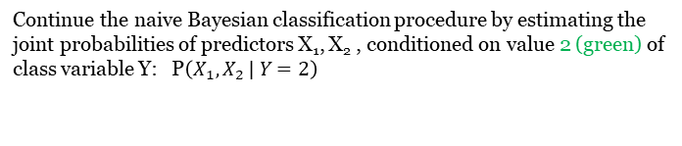
Continue the naive Bayesian classification procedure by estimating the joint probabilities of predictors X₁, X₂ , conditioned on value 2 (green) of class variable Y: P$\left(X_{1},\left.X_{2 }\right| Y=2\right)$
Naïve Bayes quiz practice. Question 3
X₁
X₁
 | 0 | 1 | 2
0 | 0.16 | 0.16 | 0.08
1 | 0.24 | 0.24 | 0.12
 | 0 | 1 | 2
0 | 0.24 | 0.08 | 0.08
1 | 0.36 | 0.12 | 0.12
X₂
X₂
a
b

Slide 58



Finish the naive Bayesian classification procedure by finding the prediction $\hat{Y}\left(X_{1}=2,X_{2}=1\right)$
Naïve Bayes quiz practice. Question 4
a. $2 −green$
b. $1 −red$

Slide 59
Naïve Bayes Quiz question 5
Which module contains constructors of different naive Bayesian classifiers?
sklearn.naive_bayes
sklearn.NB
sklearn.bayesian_algorithms
sklearn

Slide 60
Naïve Bayes Quiz question 6
Which type should X and y arguments have to be submitted to fit() method of MultinomialNB object?
Array-like
Dataframe
Series
Dictionary

